Slide 1
Facial Expression Recognition
Vivek Muskan 2017MT10755
Harsh Kumar 2017MT10729

Slide 2
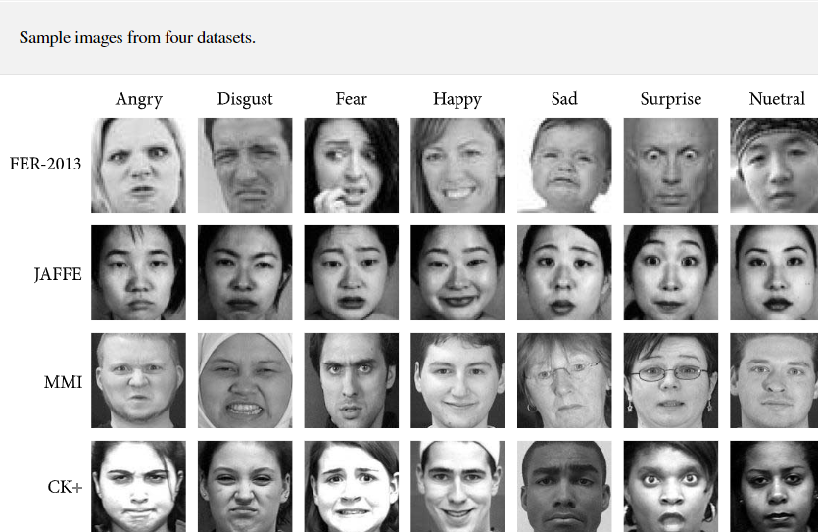
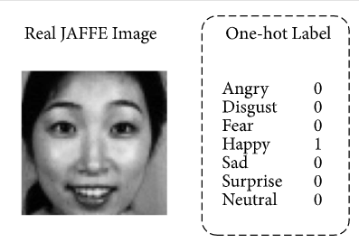
Project Overview
35000 dataset of facial expressions (48*48 pixel)
Classification of emotions

Slide 3
Road-map
Data collection and basic study
Accuracy test on Neural Network (using assignment 1 model)
Accuracy test on Convolutional Neural Network (using Keras library)
Study of further scope for increasing accuracy (GAN)
Implementation of Final Model
Report Submission
Further Extension of project to Gesture recognition

Slide 4
Road-map
Data collection and basic study
Accuracy test on Neural Network (using assignment 1 model)
Accuracy test on Convolutional Neural Network (using Keras library)
Study of further scope for increasing accuracy (GAN)
Implementation of Final Model
Report Submission
Further Extension of project to Gesture recognition

Slide 5
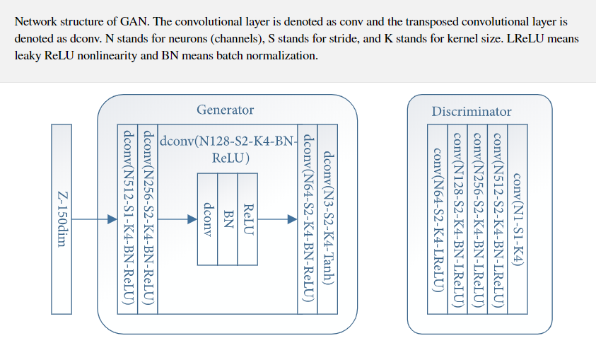
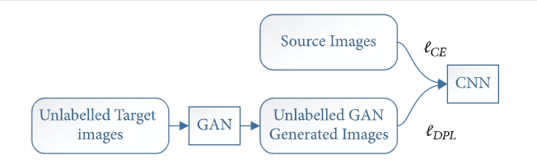
Data collection and basic study
The datasets used are available in the following repository:
http://www.kasrl.org/jaffe.htmlhttps://mmifacedb.eu/https://www.kaggle.com/c/challenges-in-representation-learning-facial-expression-recognition-challengehttp://www.pitt.edu/~emotion/ck-spread.htm.

Slide 6
Road-map
Data collection and basic study
Accuracy test on Neural Network (using assignment 1 model)
Accuracy test on Convolutional Neural Network (using Keras library)
Study of further scope for increasing accuracy (GAN)
Implementation of Final Model
Report Submission
Further Extension of project to Gesture recognition

Slide 7
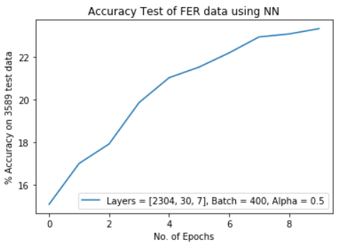
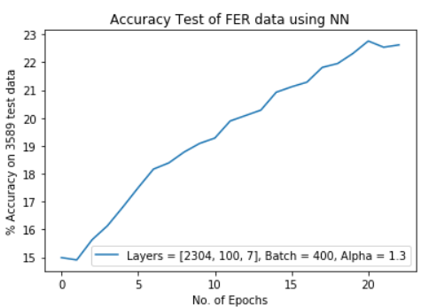
Accuracy test on NN (Assignment 1 Model)
~ 23 % Accuracy

Slide 8
Road-map
Data collection and basic study
Accuracy test on Neural Network (using assignment 1 model)
Accuracy test on Convolutional Neural Network (using Keras library)
Study of further scope for increasing accuracy (GAN)
Implementation of Final Model
Report Submission
Further Extension of project to Gesture recognition

Slide 9
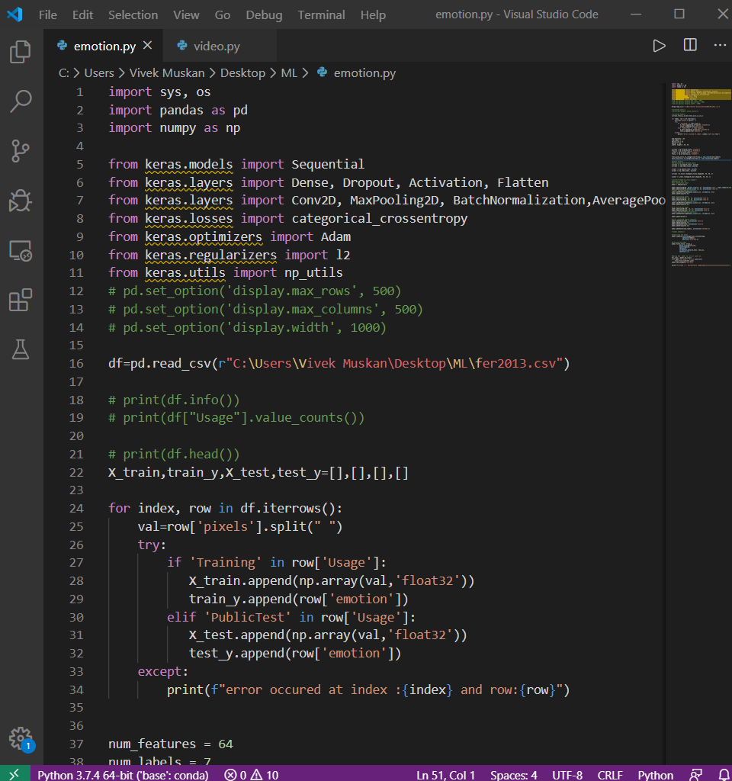
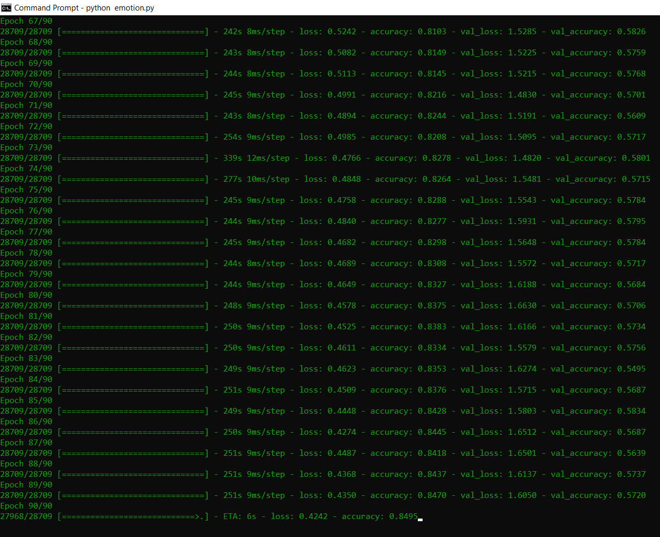
Accuracy test on CNN (Keras library)
~ 84 % Accuracy

Slide 10
Current Status
Data collection and basic study
Accuracy test on Neural Network (using assignment 1 model)
Accuracy test on Convolutional Neural Network (using Keras library)
Study of further scope for increasing accuracy (GAN)
Implementation of Final Model
Report Submission
Further Extension of project to Gesture recognition

